Slide 1






Book Recommendation System
Group Members:
Mohsin khan
Allah Rakha
Adnan Hassnain

Slide 2



Introduction
Overview of the project
Importance of book recommendation systems
Techniques used: Collaborative Filtering, Content-Based Filtering, and Association Rule Mining

Slide 3


Objectives
O1
O2
O3
Develop a hybrid book recommender system
Use collaborative filtering for user-based recommendations
Use content-based filtering to recommend books based on metadata
Implement FP-Growth to find frequent itemsets and generate association rules

Slide 4



Dataset
Context
Not only does regular reading help make you smarter, but it can also actually increase your brainpower. … With age comes a decline in memory and brain function, but regular reading may help slow the process, keeping minds sharper longer, according to research published in Neurology.
Content:
The dataset contains 25 variables and 52478 records corresponding to books on the GoodReads Best Books Ever list (the larges list on the site).

Slide 5
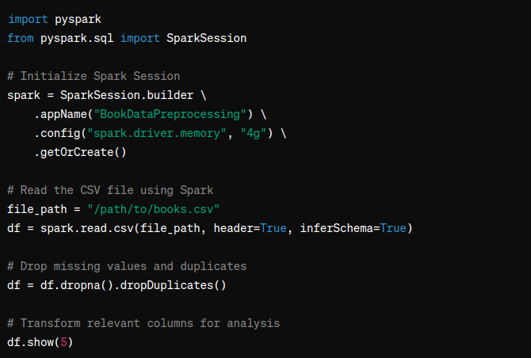
Data Preprocessing
Steps taken to clean the data
Dropping missing values and duplicates
Transforming relevant columns for analysis
Utilizing Spark for large-scale data processing(For FPG)

Slide 6
Recommender System Approaches
Collaborative Filtering:
Based on user interactions and ratings
Utilizes K-Nearest Neighbors (KNN) for finding similar users
Content-Based Filtering:
Based on book metadata (genres, authors, description)
Utilizes TF-IDF vectorization and cosine similarity

Slide 7


Application Overview
Developed a web application using Streamlit
Provides book recommendations based on user selection
Hybrid approach: combines collaborative and content-based filtering

Slide 8
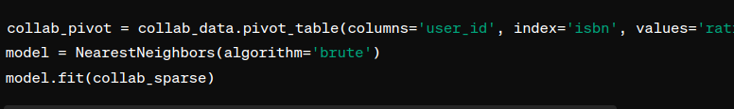
Code Explanation - Collaborative Filtering
Content:
Pivot table creation for user ratings
Applying K-Nearest Neighbors (KNN) for recommendations

Slide 9
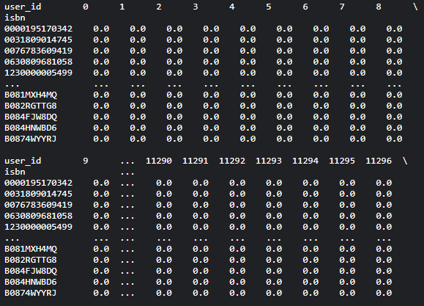

Slide 10
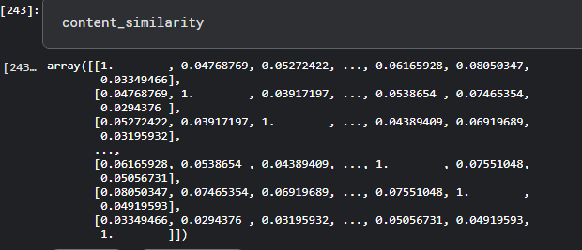
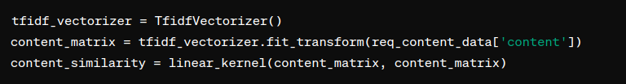
Code Explanation - Content-Based Filtering
Content:
Creating content tags using book metadata
TF-IDF vectorization and cosine similarity for finding similar books

Slide 11
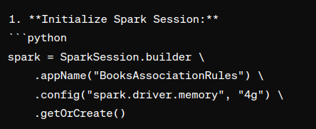
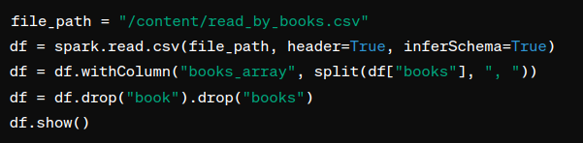
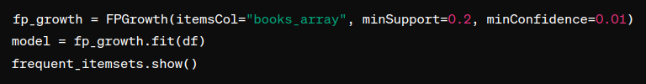
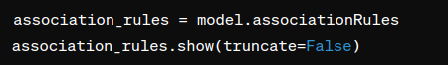
Association Rule Mining with FP-Growth
Content:
FP-Growth algorithm for frequent pattern mining
Identifying books frequently read together
Generating association rules from frequent itemsets

Slide 12
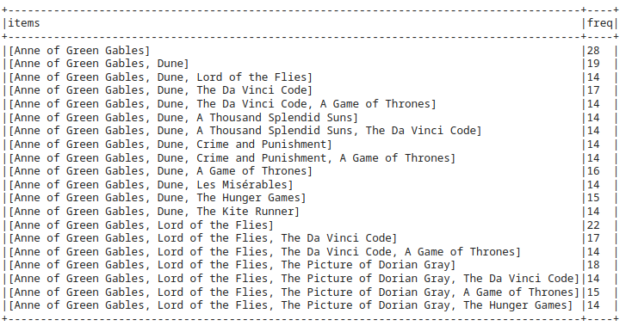
Frequent Patterns and Association Rules

Slide 13
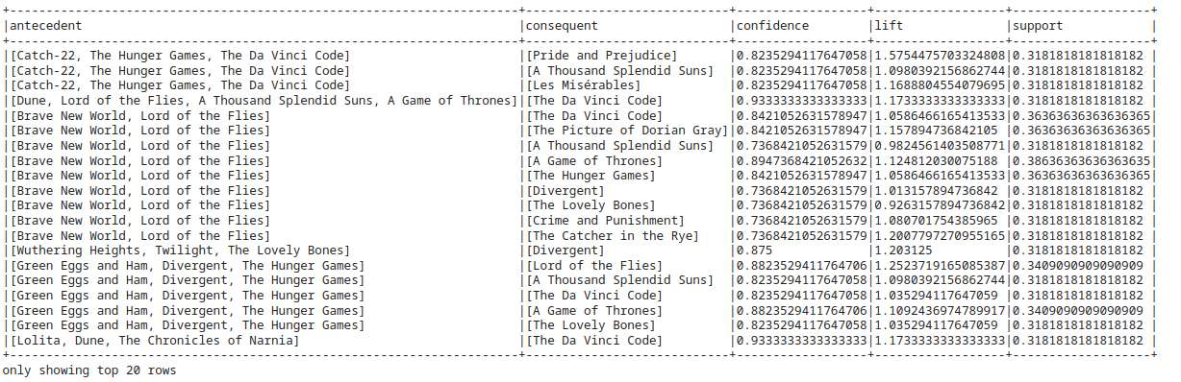
Frequent Patterns and Association Rules

Slide 14
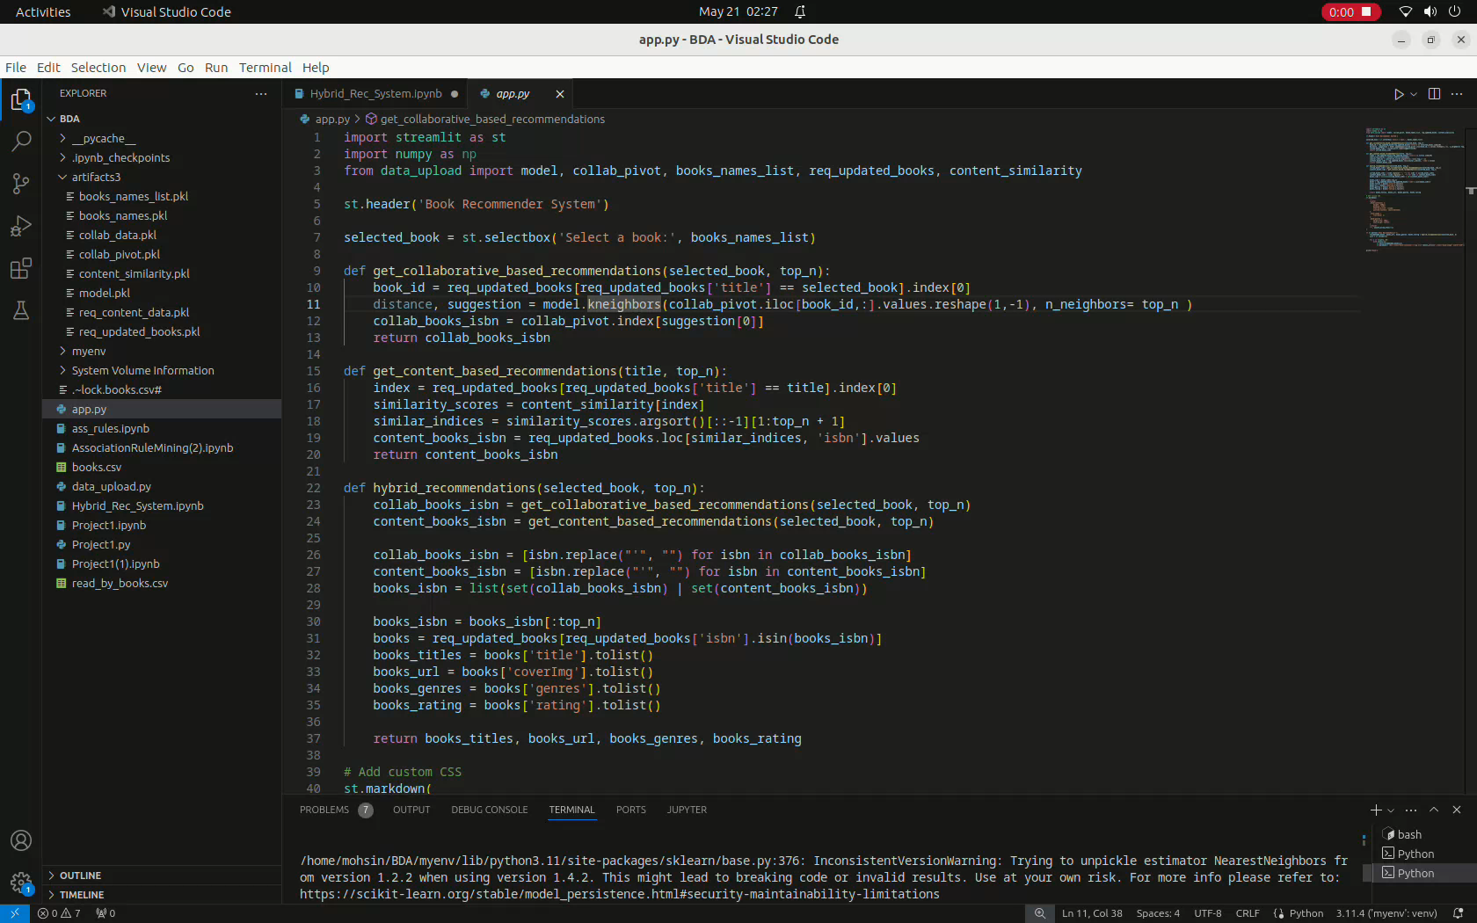
Demonstration

Slide 15
Thank You

